Slide 1
User Profiles, MySites and Audience Targeting
The SharePoint 2007 Social Collaboration Story

Slide 2
Agenda
User Profiles
My Sites
Colleagues
Personalization
Audience targeting

Slide 3
User Profiles
User profiles track user information for social networking
Information used to describe users to each other
Information users to target information to interested parties
MOSS maintains user profiles in SQL Server
Profile data can be imported from Active Directory or LDAP
Profile data can be extended with custom properties
Profiles can be extended with BDC data source
MOSS features that utilize profiles
M y Sites
Audience Targeting
People Search
Notes:
User Profiles allows a user to describe themselves to other users and discover things about each other. Properties are collected and maintained in an identity store, such as Active Directory or LDAP repositories. Typical properties includes things such as department, job title, email, etc. Once this data is imported into SharePoint it will be maintained in SQL Server. We will then be utilizing it to share the information with others and create a more personalized experience for the users.
Once the user profiles have been imported into SharePoint there are three important features that will utilize them: My Sites, Audience Targeting, and People Search. These three features provide a way to share their information with others, create a personalized experience, and find users throughout the organization.

Slide 4
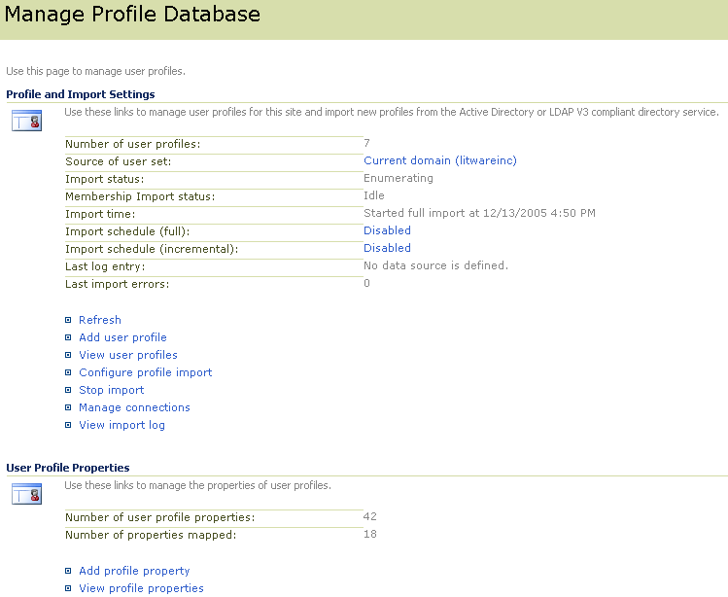
Configuring User Profiles
Administrative control for adding, viewing, managing and importing profiles
You can see and modify user profile properties
Notes:
The configuring of the User Profiles will be done in the Share Service Provider. If you are using Active Directory, you can configure MOSS to import profiles for all users within the current Active Directory domain or the entire forrest.
The page above also allows you to inspect, modify and re-import the profiles of you users.

Slide 5
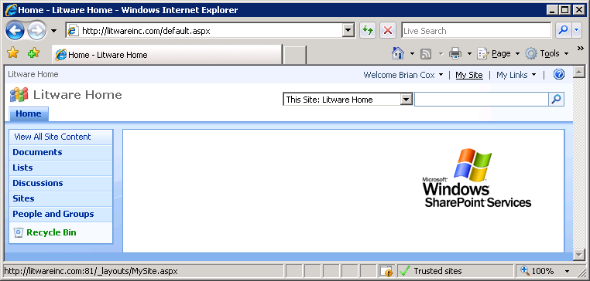
Creating a new My Site
Each My Sites is a site collection that…
is provided on demand upon first access
maps to a specific user profile
enables users to edit some aspects of their profile
Notes:
Microsoft has designed role based templates that allow an organization to provide users specific My Site templates based on their role. To access these templates visit http://office.microsoft.com/en-us/help/HA102147321033.aspx
Lastly within the SSP, the administrator does have the power to set quotas on the My Sites and define who is allowed to have a My Site based on SharePoint Groups.

Slide 6
Private vs. Public My Site Views
Private
Organize personal information
Data only they are interested in
Personalized Web Parts
Public
Share documents with Colleagues
User Profile/Contact Information
Determine who sees what information
Common Information between user and visitor
Notes:
My Sites are a feature designed for social networking. The uniqueness of an organization is held not in their product or service but in the employees. The employees hold all of the information, and my sites will allow for that information to be shared.

Slide 7
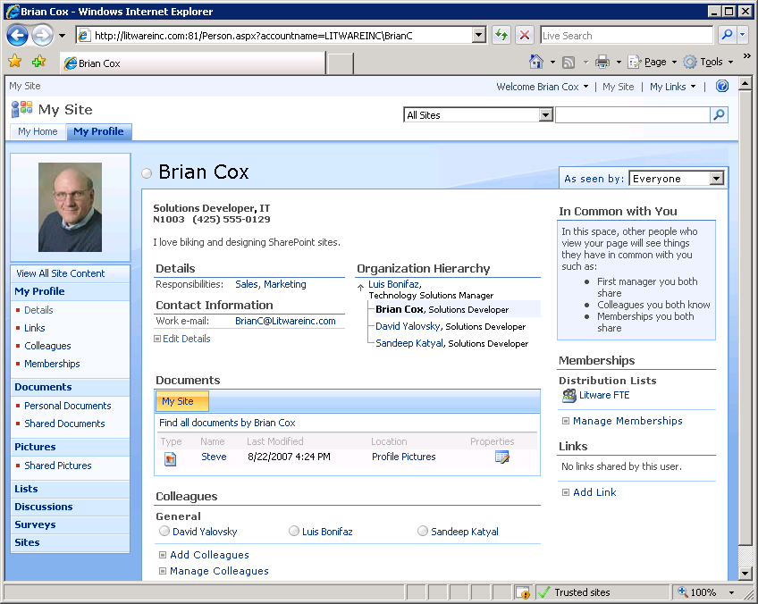
Updating A User Profile
Notes:
As long as a user has the “Edit Personal User Information” permission they may make updates to the properties of their profile the administrator has given them access to update.

Slide 8
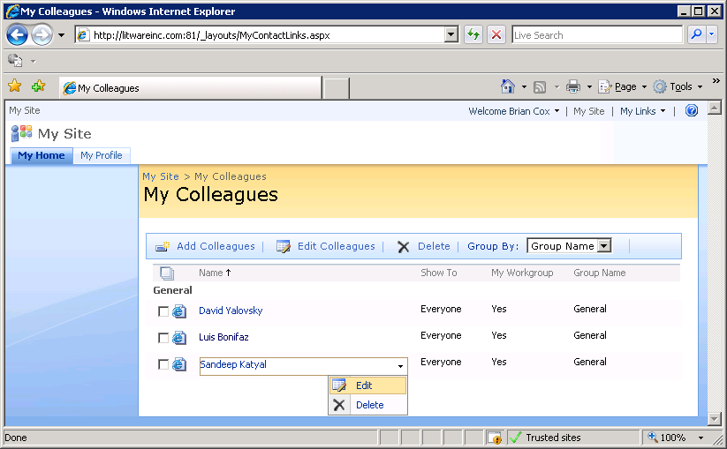
Colleagues

Slide 9
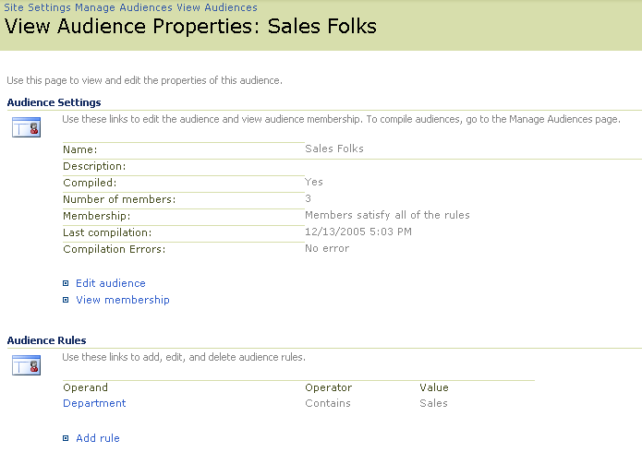
Audiences
Audience involves creating rules and then compiling
Rules define what user accounts should be included or excluded
Compilation process adds users to audience table in SQL Server
Notes:
Audiences and audience targeting provide a nice compliment to user profiles. The idea of an audience is that it provides a basis for targeting content on a WSS site page to one group of users. For example, suppose there is an announcement or weekly sales figures that only sales people would be interested in seeing on the home page of a portal site. Audience targeting allows you to add content to a page that is displayed to some users but not others.
First, you must create audiences through the SSP admin UI which involves defining criteria that can be AND-ed or OR-ed together. For example, one audience can be defined as all users in the Active Directory group named Sales. Another audience can be defines by defining criteria on user profile properties such as all users with the word "sales" in their Title or their Department as defined within their Active Directory profile. Audiences created in this manner are called global audiences.

Slide 10
Audience Targeting
Content can be targeted at an audience
The following groups can be targeted:
Distribution/Security Groups
SharePoint Groups
Global Audiences
Great way to get content to interested parties while filtering noise from those that are not interested
It is not Security!
Notes:
The last aspect of using audiences is configuring Web Parts to use them. Under the Advanced settings of the Web Part tool pane, you will have the option to target the web part.
Of course, Web part do not provide the only means to make use of an audience. You can also write custom code against the MOSS object model to programmatically determine whether the current user is in a specific audience or not. From that information, you can create a custom Web Part whose output is customized depending on what audiences the current user is in.

Slide 11
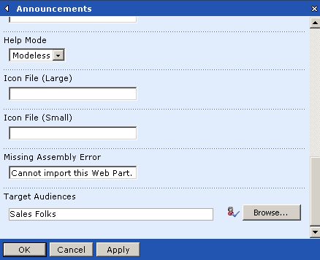
Audience Targeting (Cont.)
The following content can be targeted:
Navigational links
Web Parts
Documents in a library
Items in a List

Slide 12
Personalization Sites
Site template that allows for targeting of information
Utilizes Current User Filter Web Part
Link to site can appear in My Site navigation bar
Administrator can force link in navigation bar
User can “Pin” the site

Slide 13
Summary
User Profiles
My Sites
Colleagues
Personalization
Audience targeting

